Slide 1
Python course 2
Basic Construction: List, Loop, etc

Slide 2
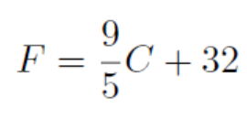
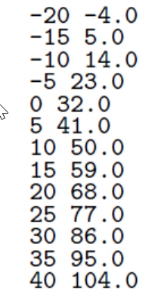
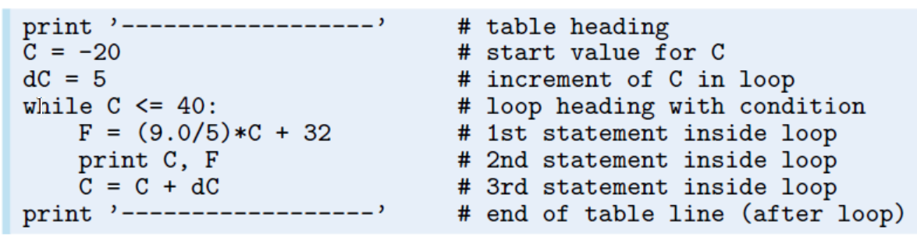
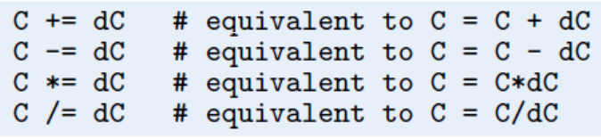
While Loop
Celsius-Fahrenheit Conversion

Slide 3
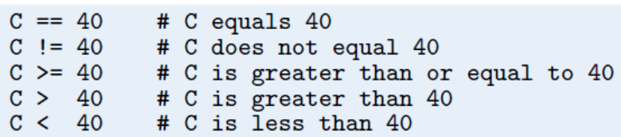
Boolean Expression
x = 0
y = 1.2
print(x >= 0 and y < 1)
print(x >= 0 or y < 1)
print(x > 0 or not y > 1)
print(-1 < x < 0)
print(not (x > 0 or y > 0))

Slide 4
List
C = [-10, -5, 0, 5, 10, 15, 20, 25, 30] # create list
C.append(35) # add new element 35 at the end
print(C)
C = C + [40, 45] # extend C at the end
C.insert(0, -15) # insert new element -15 as index 0
del C[2] # delete 3rd element
len(C)
C.index(10)
10 in C
C[1]
C[0:3]
C[-1]
C[:5]
C[5:]

Slide 5
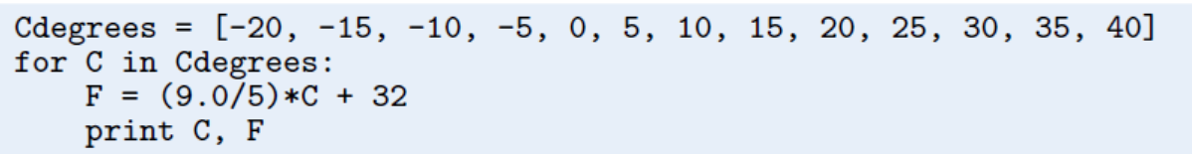
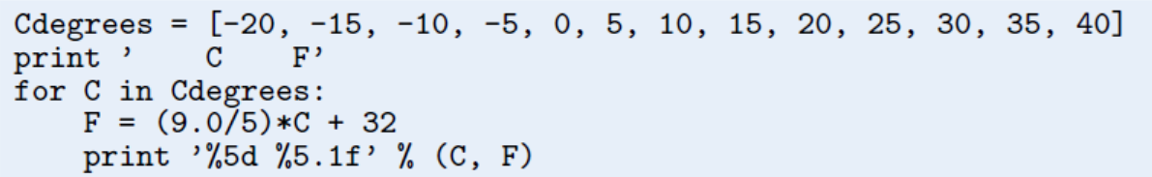
For loop

Slide 6

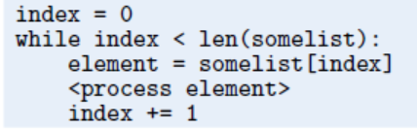
For vs While

Slide 7
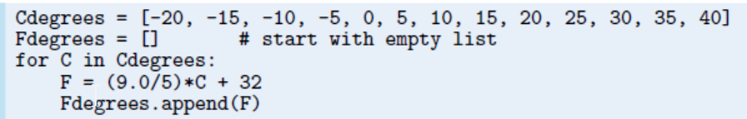
Storing the Table Columns as Lists.
print(Fdegrees)

Slide 8
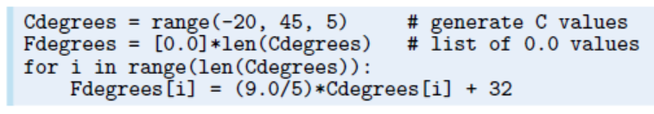
range()

Slide 9
List Comprehension
Cdegrees = [-5 + i*0.5 for i in range(n)]
Fdegrees = [(9.0/5)*C + 32 for C in Cdegrees]
C_plus_5 = [C+5 for C in Cdegrees]
for i in range(len(Cdegrees)):
print ’%5d %5.1f’ % (Cdegrees[i], Fdegrees[i])
for C, F in zip(Cdegrees, Fdegrees):
print ’%5d %5.1f’ % (C, F)

Slide 10
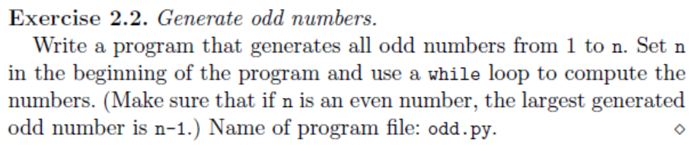
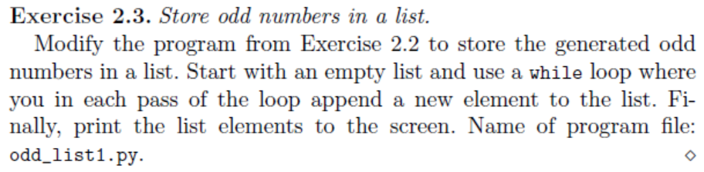

Slide 11
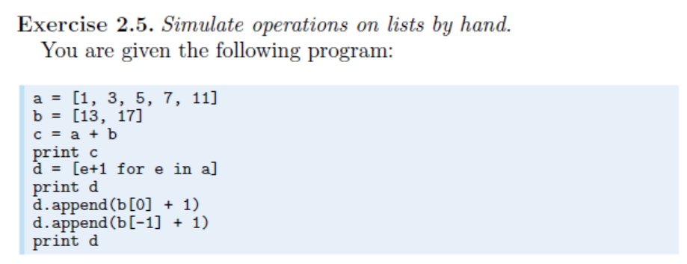

Slide 12
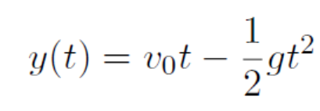
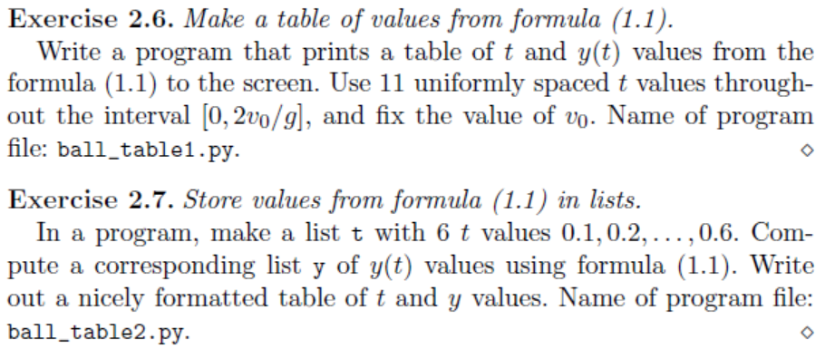

Slide 13
简单作图
import matplotlib.pyplot as plt
plt.plot(t,y,'ro-')

Slide 14
Useful tips for jupyter-notebook
Auto-complete
Help

Slide 15
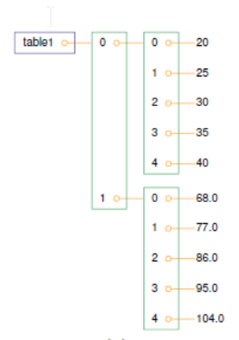
Nest List
Cdegrees = range(-20, 41, 5) # -20, -15, ..., 35, 40
Fdegrees = [(9.0/5)*C + 32 for C in Cdegrees]
table = [Cdegrees, Fdegrees]

Slide 16
Next Class

